Slide 1
CLUB ACTIVITIES
2024-25

Slide 2
WEEK 1 CLASS : VI TO IX DATE : 6.11.24
Topic : Quiz on Inventers and Inventions of the World.
Activity : Students should identify the famous inventors and inventions of the world.
Learning Outcome:
When students learn about inventors and the invention process they learn new ideas and ways of thinking. In addition, they know how to turn their ideas into realities, overcome obstacles, and turn
challenges into opportunities.

Slide 3
WEEK 2 CLASS : VI TO IX DATE : 13.11.24
Topic : Quiz on Sickness and Health.
Activity : Students will be questioned related to body parts, types of health professionals. They
would also be asked questions related to natural remedies that are available for various diseases.
Learning Outcome:
This quiz offers an opportunity to access the comprehension of disease, prevention and health
promotion strategies. By participating, students can enhance the understanding of these vital aspects of maintaining overall wellness.

Slide 4
WEEK 4 CLASS : VI TO IX DATE : 27.11.24
Topic : Quiz on Technology.
Activity : Quiz will be conducted based on the changes that have taken place in Technology in recent
years. There would be questions related to the words or abbreviations used in internet.
Learning Outcome:
Students will encounter questions covering a wide range of topics related to educational technology,
including digital tools that has been recently invented.

Slide 5
LITERARY CLUB
WEEK 1 CLASS : VIII B DATE : 6.11.24
Topic : Pass the Hat.
Activity : Two groups will be formed. Each student in a group will write a question.Group 1 will sit in a circle and pass the hat till the music plays.When the music stops the person holding hat will take the question from the lot and answer it to gain a point. The Same will be repeated to all the members in the groups. The student with maximum point wins the game.(Group 1)
Learning Outcome:
*Improves vocabulary, communication skill as well as ability to frame questions.
*Enhances sportiveness and team spirit

Slide 6
LITERARY CLUB
WEEK 2 CLASS : VIII B DATE : 13.11.24
Topic : Pass the Hat.
Activity : Two groups will be formed. Each student in a group will write a question.Group 1 will sit in a circle and pass the hat till the music plays.When the music stops the person holding hat will take the question from the lot and answer it to gain a point. The Same will be repeated to all the members in the groups. The group with maximum point wins the game.(Group 2)
Learning Outcome:
*Improves vocabulary, communication skill as well as ability to frame questions.
*Enhances sportiveness and team spirit

Slide 7
LITERARY CLUB
WEEK 3 CLASS : VIII B DATE : 27.11.24
Topic : Role Play.
Activity : Each student will enact their favourite character or role model.
Learning Outcome:
*Improves the ability to act out and make sense of real life situations
*Develop social skills
*Learn to empathize ith others.

Slide 8
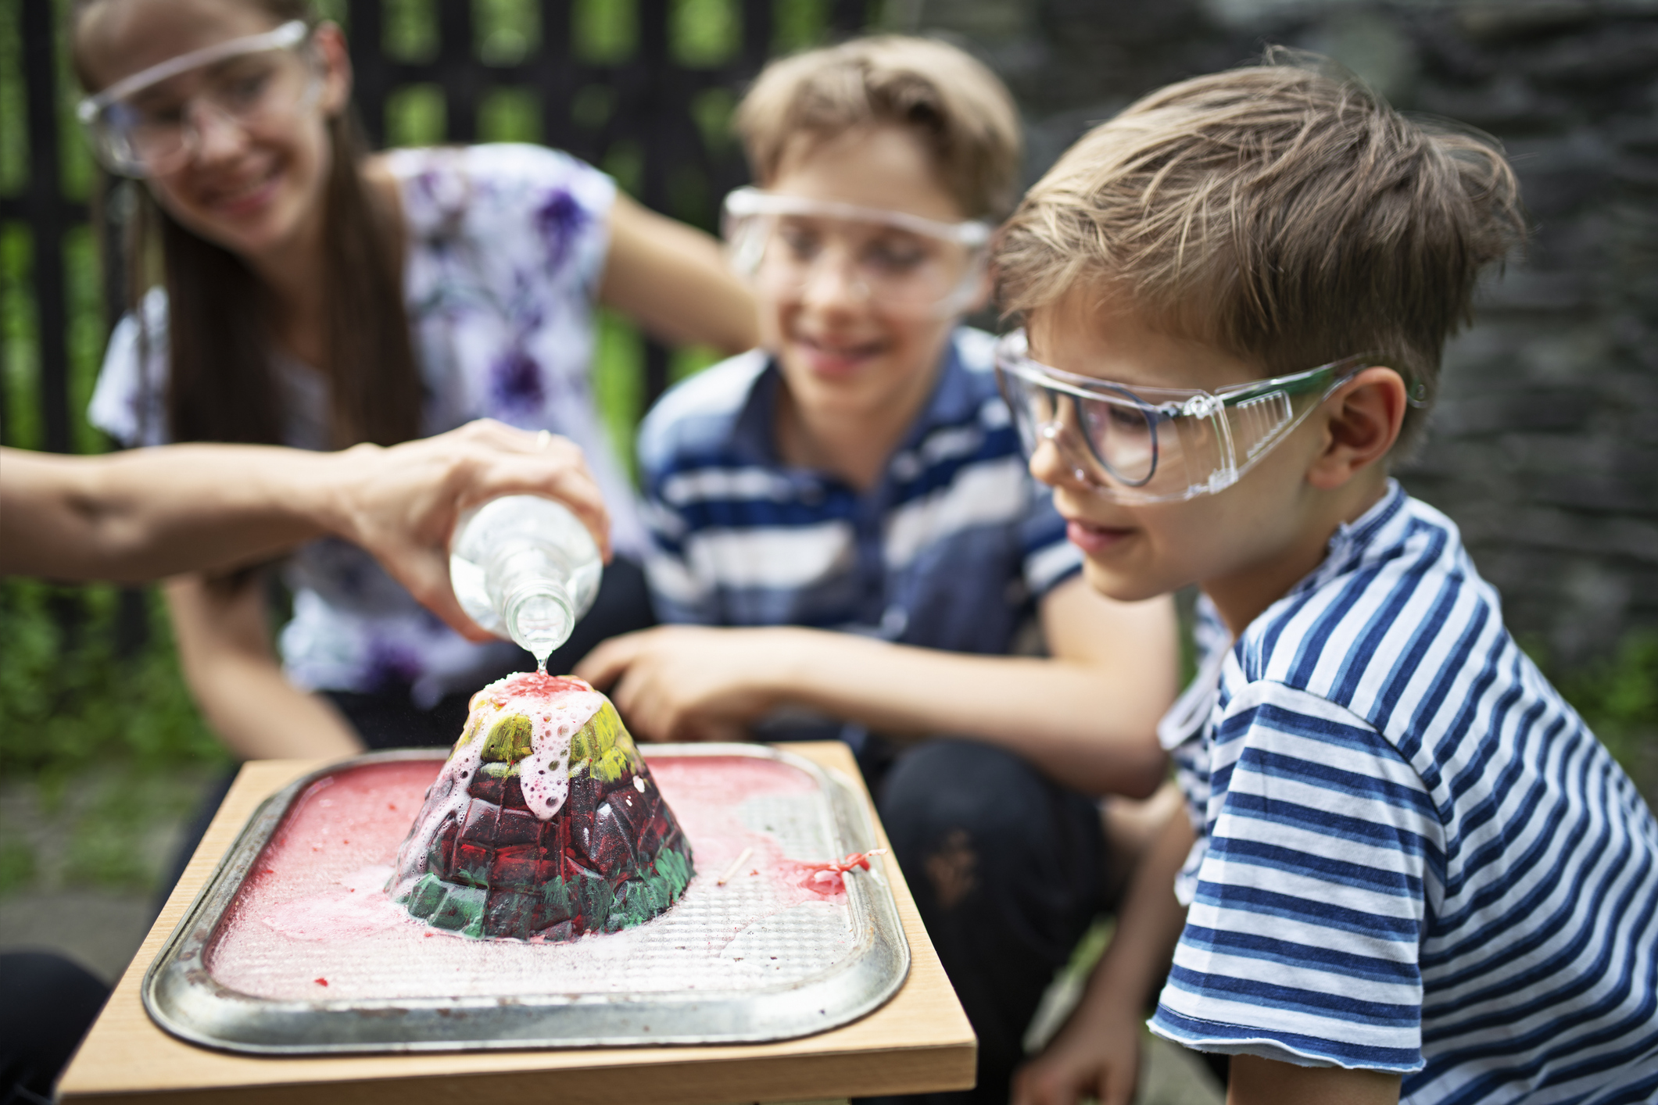
HOME SCIENCE CLUB
WEEK 1 CLASS : V B & C DATE : 6.11.24
Topic : Exercise and Fitness.
Activity : Explaining the significance of physical exercise and its relationship with the fitness of the
body.
Learning Outcome: Children will understand the role of physical activity in maintaining good health.

Slide 9
HOME SCIENCE CLUB
WEEK 2 CLASS : V B & C DATE : 13.11.24
Topic : Exercise and Fitness.
Activity : Introduce various methods of body exercises – Yoga, Aerobics, Zumba, Drill.
Learning Outcome: To help children understand about the different approaches of doing exercises.

Slide 10
HOME SCIENCE CLUB
WEEK 3 CLASS : V B & C DATE : 27.11.24
Topic : Exercise and Fitness - Competition.
Activity : Students will be briefed about the competition.

Slide 11
CLUB
WEEK 1 CLASS : III A,B,C DATE : 6.11.24
Topic : Introduction on Music
Activity : Introduction will be given on music by showing videos and asking students interest on music.
Learning Outcome: Students will demonstrate the ability to hear, identify, read, write and work conceptually with the elements of music – rhythm, melody, harmony and structure.

Slide 12
CLUB
WEEK 2 CLASS : III A,B,C DATE : 13.11.24
Topic : Beat box
Activity : Human beat box will be explained by showing video and asking kids follow the same.
Learning Outcome: Beat boxing not only teaches a greater sense of timing and rhythm, it also improves listening skills and can actually work to strengthen and protect student’s vocal cords.

Slide 13
CLUB
WEEK 3 CLASS : III A,B,C DATE : 27.11.24
Topic : Students Own Talents.
Activity : Students demonstrate their own talents on music.
Learning Outcome: Students will be express their own talents on music such as singing, playing instruments, human beat box. Interested students bring their own musical instruments.

Slide 14
VOLUNTEERING CLUB
WEEK 1 CLASS : IX B DATE : 6.11.24
Topic : Survey on cleanliness and self- cleanliness awareness to GCC workers
Activity : PPT will be shown about the duties of the GCC workers and their contribution towards cleanliness.
Learning Outcome:
Students will be able to compose and write the GCC workers contribution to the cleanliness of the
community.

Slide 15
VOLUNTEERING CLUB
WEEK 2 CLASS : IX B DATE : 13.11.24
Topic : Survey on cleanliness and self- cleanliness awareness to GCC workers
Activity : Preparation of Survey.
Learning Outcome:
To assess the effects of cleanliness measures taken by the GCC workers and to collaborate with the GCC workers and the community people to build a better community.

Slide 16
VOLUNTEERING CLUB
WEEK 3 CLASS : IX B DATE : 27.11.24
Topic : Survey on cleanliness and self- cleanliness awareness to GCC workers
Activity : Field Trip: Learners will be taken to nearby community for awareness of cleanliness and to support GCC workers.
Learning Outcome:
Learners will reflect and role-play their contribution on the cleanliness of the community.

Slide 17
SPORTS CLUB
WEEK 1 DATE : 6.11.24
Topic : Introduction to Over hand service in volley ball(Ball Toss)
Activity : Specific warmup, rotation, teaching the skills, practicing the skills, lead up activity, warm down.

Slide 18
SPORTS CLUB
WEEK 2 DATE : 13.11.24
Topic : Wall Serve
Activity : Specific warmup, rotation, teaching the skills, practicing the skills, lead up activity, warm down.

Slide 19
SPORTS CLUB
WEEK 3 DATE : 27.11.24
Topic : Partner Serve (Progression)
Activity : Specific warmup, rotation, teaching the skills, practicing the skills, lead up activity, warm down.

Slide 20
PHILATELY CLUB
WEEK 1 CLASS : VI to IX DATE : 6.11.24
Topic : Stamp designing contest
Learning Outcome: Children will learn to recollect and share the learnt concepts about stamps and develop their competency spirit.

Slide 21
PHILATELY CLUB
WEEK 2 CLASS : VI to IX DATE : 13.11.24
Topic : Visit to Post office
Learning Outcome: Exhibition related work.

Slide 22
PHILATELY CLUB
WEEK 3 CLASS : VI to IX DATE : 27.11.24
Topic : Letter Writing
Learning Outcome: This activity helps children to share the views about their visit to the post office through the letter writing to post master of the GPO.

Slide 23
KARUNA CLUB
WEEK 1 Class V-C,D DATE :6.11.24
Topic : Old Age Home - Field Trip.
Activity :Visit to old age home.
Learning Outcome: Children learn the values like Self-compassion, Empathy and kindness toward elders. To be a responsible
citizen.

Slide 24
KARUNA CLUB
WEEK 2 Class V-C,D DATE :13.11.24
Topic : Make a Paper Bag.
Materials Needed: Newspaper
Learning Outcome: To be environmentally
friendly., recyclable and reusable

Slide 25
KARUNA CLUB
WEEK 4 Class V-C,D DATE :27.11.24
Topic : Decorating a Jute Bag on topic Save Earth.
Materials Needed: Jute Bag.
Learning Outcome: To be eco-friendly.

Slide 26
WEEK 1 Class VI B DATE :6.11.24
Topic : How Mobile Phone Impact Students’ Lives?
Activity: Negative Impact of Smartphones on Students.
Learning Outcome: Limit students’ screen time. Encourage them to take breaks while surfing
the Internet.

Slide 27
WEEK 2 Class VI B DATE :13.11.24
Topic :Impact of gaming on children.
Activity: Mobile game usage is linked to lower academic performance. Another meta-analysis study
found that mobile phone usage, including the use of mobile games, had a negative effect on student educational outcomes.
Learning Outcome: The adverse impact is the degraded social life of children. Spending excessive time playing video games can isolate
children.

Slide 28
WEEK 4 Class VI B DATE :27.11.24
Topic :Slogan Writing
Activity: Slogans are used to convey a message about the service or cause that it is representing.
Learning Outcome:Learn to write their own slogans on the impact of usage of smart phones.

Slide 29
LOVELY SINGING CLUB
WEEK 1 Class: I - A&B DATE :6.11.24
Topic : Put your right hand in Boogie boogie
Learning Outcome: Action songs require children to listen and follow directions in order to sing, move, take turns, develop new ideas.

Slide 30
LOVELY SINGING CLUB
WEEK 2 Class: I - A&B DATE :13.11.24
Topic : Put your right hand in Boogie boogie
Learning Outcome: Action songs require children to listen and follow directions in order to sing, move, take turns, develop new ideas.

Slide 31
LOVELY SINGING CLUB
WEEK 1 Class: I - A&B DATE :27.11.24
Topic : Put your right hand in Boogie boogie
Learning Outcome: Action songs require children to listen and follow directions in order to sing, move, take turns, develop new ideas.

Slide 32
DISASTER MANAGEMENT CLUB
WEEK 1 Class VII A & C DATE :6.11.24
Topic :Possible Risk Reduction measures for Landslides.
Activity: Students will exhibit the impact and preventive measures of Landslides through Models.
Learning Outcome: Students will understand the concept of Landslides and the geographical area that are prone to Landslides and the preventive measures.

Slide 33
DISASTER MANAGEMENT CLUB
WEEK 2 Class VII A & C DATE :13.11.24
Topic : Types of Industrial Hazard.
Activity:The students to detail about the types of Industrial hazards and preventive measures through Puppets
Learning Outcome: Students will gain knowledge about the different safety measures that needs to be adapted in Industrial Units to avoid Hazards.

Slide 34
DISASTER MANAGEMENT CLUB
WEEK 4 Class VII A & C DATE :27.11.24
Topic : Prevention of Electrical Hazards - Person from EB will visit the school and explain the safety measures.
Activity: Students will be educated about the electrical hazards and its prevention
through Videos
Learning Outcome:Students will be able to learn about various precautions to be taken to handle Electrical equipments in daily life.

Slide 35
WEEK 1 Class IV A DATE :6.11.24
Topic :Christmas crafts.
Activity: Christmas tree
Learning Outcome: It offers hands on tactile experience that promotes fine motor skill, creativity and imaginative play.

Slide 36
WEEK 2 Class IV A DATE :13.11.24
Topic :Fan
Activity: Paper Fan Toys.
Learning Outcome: It will develop spatial reasoning skills. Children will learn to make use of repurpose material.

Slide 37
WEEK 4 Class IV A DATE :27.11.24
Topic :Mdf board art.
Activity: Painting done on mdf board motif.
Learning Outcome: Experimenting with colors, shapes and techniques encourages critical thinking and problem solving as children explore different ways to promote their artistic vision.

Slide 38
NATURE CLUB
WEEK 1 Class II A&B DATE :6.11.24
Topic : Painting the pebbles.
Materials Required: Different shapes of Pebbles.
Activity: Students will paint the pebbles using different colours of their choice. They can draw different shapes of natural things.
Learning Outcome:Students will get hands on experience with sensory and motor skills.

Slide 39
NATURE CLUB
WEEK 2 Class II A&B DATE :13.11.24
Topic : Poster making activity (Protecting the Environment)
Materials Required: Chart, sketch, crayons.
Activity: Students will create their poster using chart.
Learning Outcome: Students will realize the dual nature of a poster as a visual
communication and art object.They will come to know the purpose of a poster.

Slide 40
NATURE CLUB
WEEK 4 Class II A&B DATE :27.11.24
Topic : Leaf faces using fresh and dried leaves.
Materials Required: Dried leaves, Paper Plate, Gum, Fresh Leaves, Twigs.
Activity: The students will be learning about leaf faces using dried and fresh item
Learning Outcome: It will help the students to stimulate the creativity, imagination and develops fine motor skills.

Slide 41
WEEK 1 Class VI A&C DATE :6.11.24
Topic : Osmosis- Gummy bear science experiment
Activity: If a gummy bear is placed in water, then the gummy bear will swell. If a gummy bear is then placed in a
higher salt water concentration, then the gummy bear will decrease in volume and mass.
Learning Outcome:Students understand the concept of
osmosis. Students understand the cause for osmosis. • Students understand the importance of osmosis in plant and animal cells.

Slide 42
WEEK 2 Class VI A&C DATE :13.11.24
Topic : Build a popup bottle Eco system
Activity: A model that allows students to explore the
relationship between elements that live or relate to both aquatic and land habitats.
Learning Outcome:Students will learn the role of each
biotic and abiotic component in the ecosystem.

Slide 43
WEEK 4 Class VI A&C DATE :27.11.24
Topic : Oxidation experiment- Invisible Ink.
Activity: The juice of the lemon oxidizes when it is heated , changing its color.
Learning Outcome:Students will learn the impact of sunlight and how to make natural ink.

Slide 44
TOURISM CLUB
WEEK 1 Class IX A&C DATE :6.11.24
Topic : Brochure making.
Activity: Draws, illustrates, mapping , guide, location.
Learning Outcome:Educational brochures are a fun and easy way to showcase materials with both imagery and text and get students up to speed. To bring knowledge about travel and tourism its important to know about travel Brochure.

Slide 45
TOURISM CLUB
WEEK 2 Class IX A&C DATE :13.11.24
Topic : Local Tour.
Activity: Travel to locations in off peak period which would help boost local tourism economy.
Learning Outcome:To encourage students to visit nearby local tourist spots.To create opportunities for learners/members to interact,
appreciate, and understand local culture and ways of life during travel tours.

Slide 46
TOURISM CLUB
WEEK 4 Class IX A&C DATE :27.11.24
Topic : Media & Public relations.
Activity: Importance of Media in Yuva Tourism.
Learning Outcome:learners will pass on information about activities
involving immediate community to local media.

Slide 47
HERITAGE CLUB
WEEK 1 Class IV B DATE :6.11.24
Topic : Story Telling session- 1- Stories behind the famous paintings in
the world.
Activity: Children’s are asked to tell story about the famous paintings in the world.
Learning Outcome:Children will use imagination and creativity. It increases verbal proficiency. Encourage active participation.

Slide 48
HERITAGE CLUB
WEEK 2 Class IV B DATE :13.11.24
Topic : Story Telling session- 1- Stories behind the famous paintings in
the world.
Activity: Children’s are asked to tell story about the famous paintings in the world.
Learning Outcome:Children will use imagination and creativity. It increases verbal proficiency. Encourage active participation.

Slide 49
HERITAGE CLUB
WEEK 4 Class IV B DATE :27.11.24
Topic : Heritage City of India - Ahmedabad(Lippan art work)
Materials Required: Children’s are asked to bring glue,brush,clay. Acrylic colours, Mirrors of different shapes and square shaped cardboard.
Learning Outcome:Helps children learn to communicate and think for themselves. It provides opportunity to create, share and convey meaning using non-verbal ways.

Slide 50
HEALTH AND WELLNESS CLUB
WEEK 1 Class VIII A & C DATE :6.11.24
Topic : Guest lecture on “Tips for self-care”.
Activity: Students are advised to do activities and
practices that can engage in on a regular basis to maintain personal hygiene.
Learning Outcome:Students can understand to
evaluate their self-care routine and create a self-care plan that is effective and manageable.

Slide 51
HEALTH AND WELLNESS CLUB
WEEK 2 Class VIII A & C DATE :13.11.24
Topic : Visit to fitness centre(Gym)
Activity:Fitness is a condition that helps us look, feel
and do our best. It increases the muscle strength and flexibility of body.
Learning Outcome:Students can understand the
benefits such as getting fit, weight loss, improving flexibility, reducing stress, improving self- esteem and confidence.

Slide 52
HEALTH AND WELLNESS CLUB
WEEK 4 Class VIII A & C DATE :27.11.24
Topic : Quiz on Human Health and diseases.
Activity:To test the knowledge of students on
communicable and non-communicable diseases.
Learning Outcome: Students can understand the norms of good health, to take precautionary and preventive measures against communicable
and non-communicable disease.

